Slide 1
Detection of COVID-19, Pneumonia, and Tuberculosis Using Convolutional Neural Networks

Slide 2
1.INTRODUCTION:
Indoor air pollution is a major cause of pneumonia in children, a severe acute respiratory illness that affects people at both ends of the age spectrum. Pneumonia leads to over a million hospital admissions and around 50,000 adult deaths annually in the US. Diagnosing pneumonia involves various techniques such as physical exams, medical histories, clinical tests, and imaging like chest X-rays. In the 1800s, William Osler referred to pneumonia as "the captain of the men of death."

Slide 3
2.LITERATURE SURVEY:
The problem of categorizing chest X-ray images into distinct classifications in medical diagnostics has been thoroughly investigated, with various techniques employed to reduce dimensionality.
Artificial neural networks have been evaluated to identify lung conditions such as lung cancer, pneumonia, and TB.
Recently, machine learning techniques for the identification of thoracic illnesses have gained more attention in medical image categorization studies.
Lakhani and Sundaram (2017) developed a method using two different CNNs, AlexNet and GoogleNet, for diagnosing pulmonary TB.

Slide 4
3. METHODS:
1.CNN:
A convolutional neural network (CNN) is a type of deep neural network used to analyze visual images, consisting of input, hidden, and output layers. Our CNN model includes ten layers: two thickness layers, one smoothing layer, one output layer, three MaxPooling2D layers, and three Convolution2D layers.

Slide 5
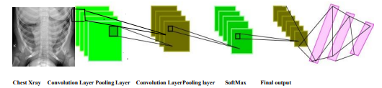
1.Convolution Layer:
A picture input is transformed into a matrix form, convolved with a 3x3 filter to produce a feature map. This reduces the image size, simplifying processing while retaining essential components, despite some information loss.

Slide 6
2. Max-Pooling Layer:
The pooling layer's objective is to further down-sample the input image. To put it another way, to make the input image smaller.
As a result of the image's fewer parameters, the computational complexity is decreased.
The models employ max-pooling and average-pooling subsampling techniques.
A sample-based discretization technique is called max-pooling. Each feature map is processed by the dimension 2X2 pooling layer, which uses the 'MAX' function to scale the dimensionality.

Slide 7
3.TRANSFER LEARNING:
Transfer learning is a powerful deep-learning technique. Applying a model that has already been trained to a new problem is known as transfer learning.
Transfer learning is a technique whereby pre-trained machine learning model data is migrated to a different but related model.
Transfer learning is a concept that may be used for a smaller dataset by using a trained model from a larger dataset, such as ImageNet.

Slide 8
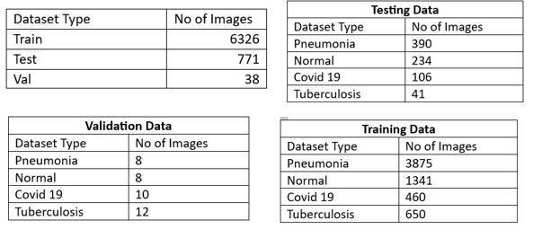
Experimental Dataset
The combination of the Covid-19 chest x-ray, tuberculosis, and pneumonia datasets is the dataset that we used.
The datasets we downloaded from Kaggle include Chest X-ray Images (Pneumonia) , Chest X-ray (Covid-19 & Pneumonia), Curated COVID-19 Chest X-ray dataset, and Tuberculosis (TB) Chest X-ray Cleaned Database.

Slide 9
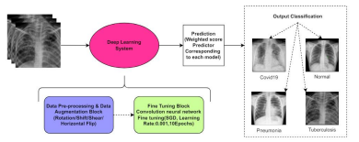
PROPOSED METHODOLOGY:
This study suggests the best method for determining pneumonia using chest X-rays. Methods for augmenting data were applied to grow the little dataset. The predictions from these models were then combined with a weighted classifier to determine the final forecast. The whole block diagram of the recommended method is shown in figure

Slide 10

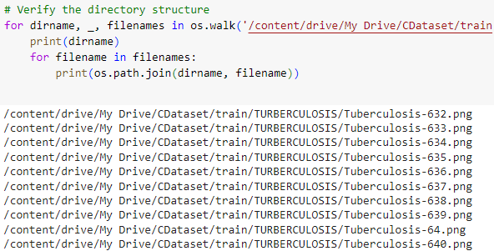
PRE-PROCESSING & DATA AUGMENTATION:
Resizing the X-ray images was a crucial step in the data preprocessing process because different algorithms required varied image input sizes. We set the model's input size to 224,224,3, where 224,224 is the image form and 3 is the number of channels (R, G, and B). Thus, we changed the form of our input image to 224,224.

Slide 11
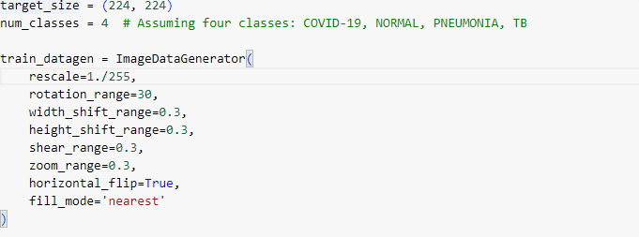

Data Argumentation

Slide 12
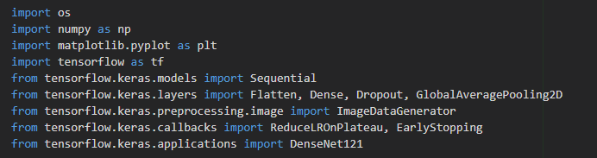
EXPERIMENTAL SETUP:
This section presents the experiments and assessment methods utilized in the research to assess the suggested model's efficacy. Utilized was the chest X-ray image collection that was suggested. The pre-trained architectures were loaded onto the ImageNet Dataset using the open-source keras deep learning framework, which was then tuned for the given job using TensorFlow as the backend.

Slide 13
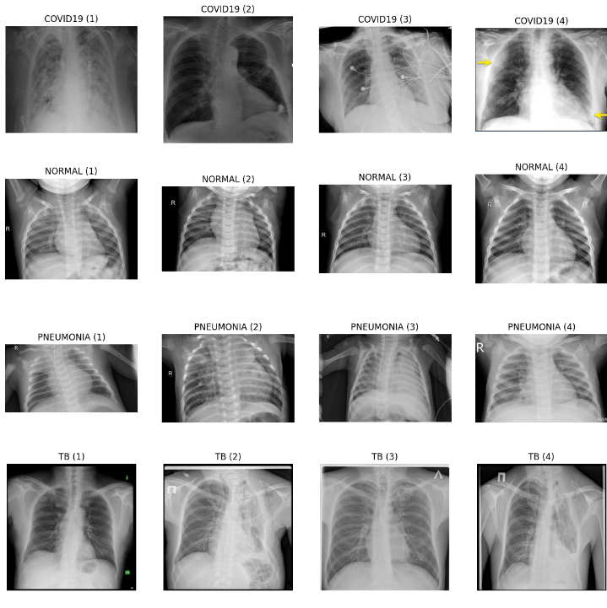
EXPERIMENT RESULTS AND DISCUSSION:
A collection of 16 images from the training dataset is shown, along with the names of their classes. It initially pulls data from the training generator, including class names and related indices. It then obtains an album of pictures together with their captions. It displays each of the first 16 photographs in this batch in a 4x4 grid and normalizes the pixel values for better viewing. Each image's title is set to the name of its class, which is found in the label array by showing the class with the highest probability. For a more polished appearance, the axes are off. The plot is finally shown.

Slide 14
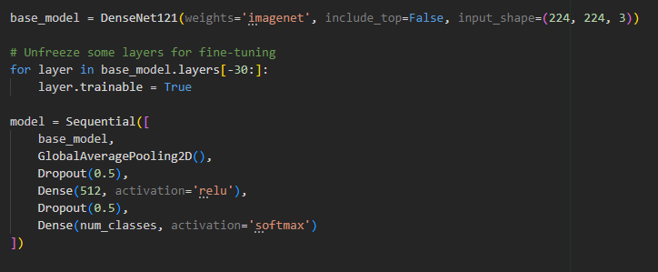
Building the Model
Adding Callbacks to increase the accuracy of base Model

Slide 15
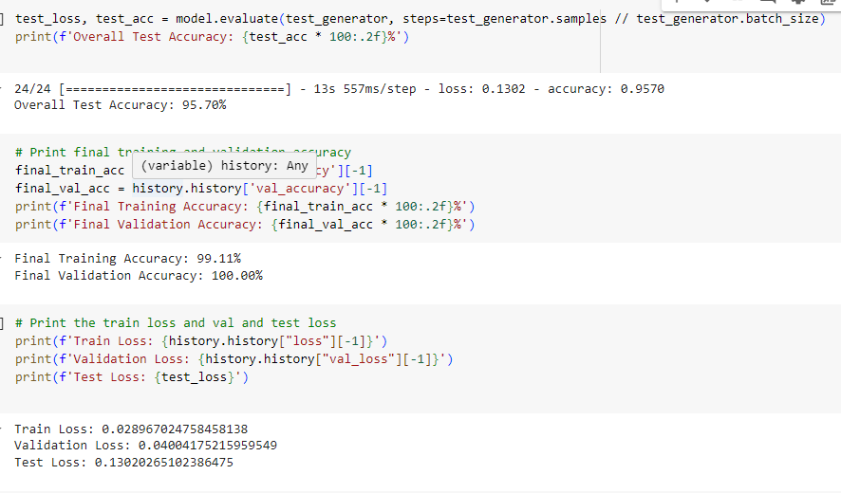
RESULTS:
We achieved a test accuracy of 99.11 % of accuracy with Proposed_CNN_DensNet121. We achieved train accuracy as 96.79% and validation accuracy as 99.76%
 | Accuracy | Loss
Training | 99.27 | 0.02
Testing | 99.11 | 0.13
Validation | 100 | 0.03

Slide 16
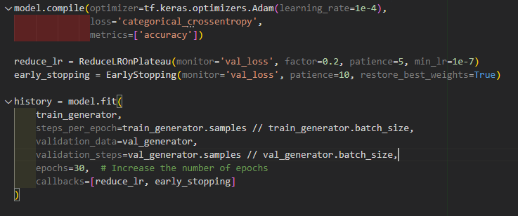
Compiling the Model

Slide 17
Printing the results:

Slide 18
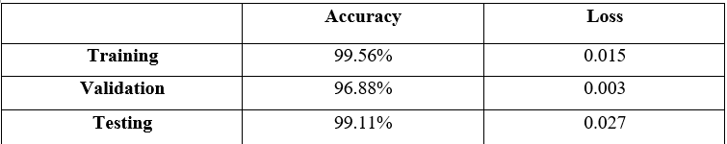
Result in Terms of Testing Accuracy and Testing Loss:
Google Colab is used to implement the suggested tasks in Python. First, we used the CNN model to train this dataset. But the outcome was not better. Later, we raised the number of epochs to 30 and made modifications to a few layers to improve the findings. To reflect better outcomes, we are concerned with the loss function, optimizer, epochs, batch size, and layers.

Slide 19
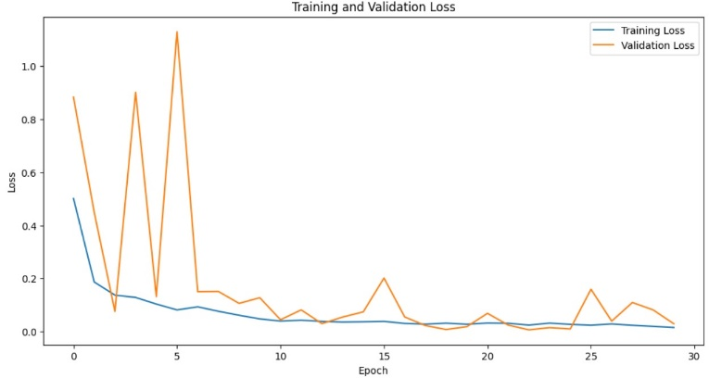
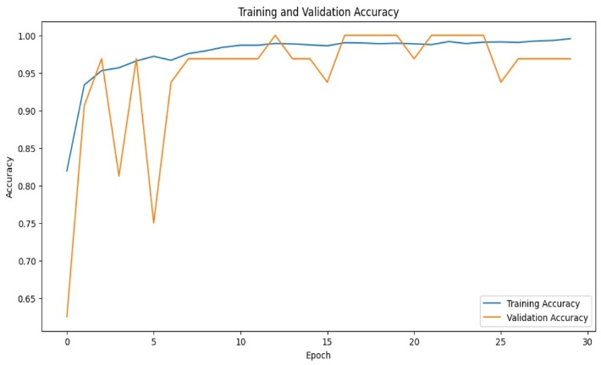
The above graphs show the accuracy and loss during training and validation for a machine-learning model over a number of epochs.
Accuracy Vs Loss
Training and validation loss
Training and Testing Accuracy

Slide 20
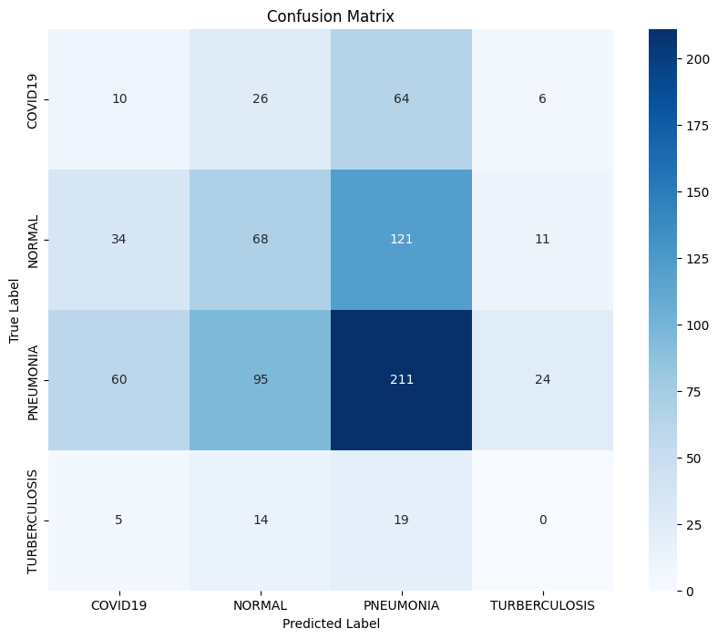
Confusion Matrix:
Test Data (CNN Model)
We applied for the CNN model and got the following confusion matrix. Following the conclusion of the training phase, each model was evaluated using the test dataset. F1, the area under the curve, accuracy, recall, and precision were used to validate their performance. The discussion of each performance statistic utilized in this article follows.

Slide 21
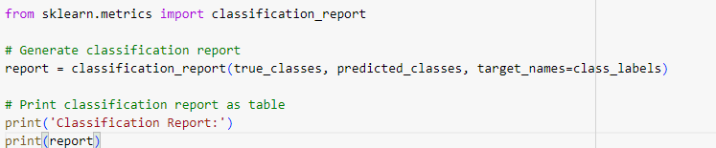
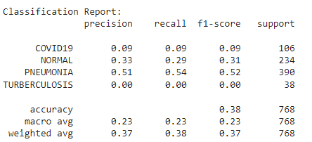
Classification Report:

Slide 22

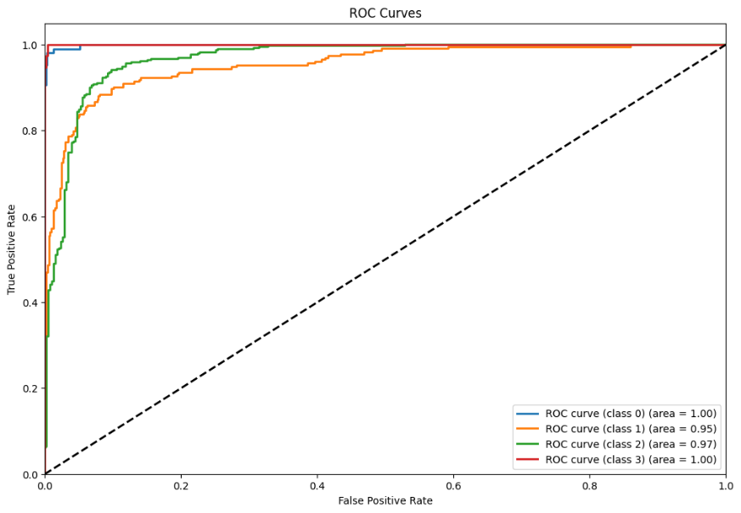
ROC CURVE:
The suggested classifier and the ROC curves for distinct designs are displayed in this figure
The suggested classifier was able to obtain the highest AUC score of 97.7%. Every model displayed a comparable AUC/ROC curve. The weighted classifier produced the greatest results, according to the analysis, with an AUC score of 97.7%, an F1 score of 1.00, and a test accuracy of 98%.

Slide 23
Classification Report:
Covid19: Excellent recall and precision, but marginally worse recall than other classes, which results in a marginally lower F1-score.
Normal: Reliable performance with a slightly higher recall than precision, showing high precision and recall.
Pneumonia: Pneumonia occurrences are flawlessly classified by the model, as seen by perfect scores for all criteria.
Tuberculosis: Reliable performance is indicated by a balanced and high F1-score, together with excellent precision and recall.

Slide 24
CONCLUSION AND FUTURE SCOPE:
In this paper, we attempt to find a simpler approach for pneumonia detection for chest X-ray images by comparing the different architectures on the same dataset. Based on our findings, we selected the most perfect model, which is easy to train and has one of the best performance metrics. There are several approaches to detecting pneumonia using CNN, and it gives better accuracy, recall, and F1 score. We are using deep learning algorithms that have proven to be more realistic. It can also be observed that the accuracy of the network can be increased by preprocessing techniques. CNN model to provide efficient accuracy and the best solution for pneumonia detection based on chest X-ray image.

Slide 25
THANKYOU

